Slide 1
Approaches to Writing a Research Proposal
RR Townsend
Clinical Research 101
November 13 2019
1125h – 1200h

Slide 2
The absolutely-don’t-forget-this list
Deadlines are that: if you don’t get it submitted in time, it’s dead
A grant is many faceted beast – you need ruthless readers, brilliant biostatistics, great grants-admins, and an innovative idea
Keep it simple
Keep it focused on your Hypothesis and AIMS
Pay attention to the details like font size and margins

Slide 3
The essential list
Is this Scientifically important (impact)?
Is it Innovative?
Is it plausible and is the Approach sound and if successful will the scientific question be answered?
Is the Investigator ‘credible’?
Is the Environment ‘credible’?

Slide 4
STEP 1 - PLANNING CLINICAL RESEARCH
Asking the question
  It does NOT have to be brilliant
    (sure it helps)
  It does NOT have to “cure” something
    (THAT would actually be quite attractive but its usually quite unrealistic)
  It SHOULD be at the least somewhat important
  It SHOULD be testable

Slide 5
Step 1A – Introduction (“the grabber section”)
Your first page in a grant application is crucial
If you have not grabbed your reviewer’s attention by the end of page 1 of your grant’s research section you’re sunk
Reviewing a grant that appears poorly thought out, addresses a problem of little significance, has an unconvincing introduction to the importance of this science or the unmet needs, or recapitulates work from the center where the investigator resides will hurt your composite score

Slide 6
You usually need to have a hypothesis
Nocturnal blood pressure variability is an independent contributor to cardiovascular morbidity and mortality in people with hypertension

Slide 7
You usually need several AIMS
H₀: Nocturnal blood pressure variability is an independent contributor to cardiovascular morbidity and mortality in people with hypertension
This Hypothesis will be tested through the following AIMS
AIM1: To determine the magnitude of nocturnal blood pressure variation measured at 30 minute intervals in patients with hypertension
AIM2: To determine whether nocturnal variation in blood pressure is related to demographic and racial factors such as age, gender, race, and ethnicity
AIM3: To assess whether cardiovascular morbidity occurrences such as MI, heart failure, stroke, and death occur more frequently in patients with greater nocturnal blood pressure variation

Slide 8
STEP 2: Convince your Readers and Reviewers
Why your approach will differ from what has been done already, or improve upon existing knowledge, or come at a problem from a different angle. Innovation is important in your scoring composite and it’s OK to state plainly how your study will move the field forward in a novel fashion.

Slide 9
STEP 3: Preliminary Data
Not always needed, but usually an essential aspect to your grant
For 2 reasons
First – it shows you can make the measurements or assemble the data or whatever
Second – hopefully it shows tendencies that support your H₀
The TRICK in this is to whet, but not satiate, the appetite
If your preliminary data already shows pretty solidly what you want to pursue in the grant, why do you need (more) funding?

Slide 10

Designing the study
How many people (shallow vs wide)
People, or other materials (like DNA)
Intervene, or observe, or query, or other
How many measurements; and of what
Use existing data, or generate your own
Where do you find these
  people/specimens/data/DNA
Who watches over my study

Slide 11



Pitfalls in designing clinical research
Marriage to an AIM
IRB issues
Power

Slide 12
Some suggestions
Send your colleagues your first page with introduction, hypothesis/hypotheses and AIMS.
Don’t wait till a few days before a grant deadline to seek input
Talk with your grants administrator – you may not be able to afford what you are planning at first go around
DEVELOP A CHECKLIST!!
The statistical approach may seem “back room” to you but this will bite you if not done well. The reviewing agency will usually have an army of biostats reviewers looking over the applications. Talk with biostats early and often and leave enough room in the page restriction for data management, power, and statistical analysis

Slide 13
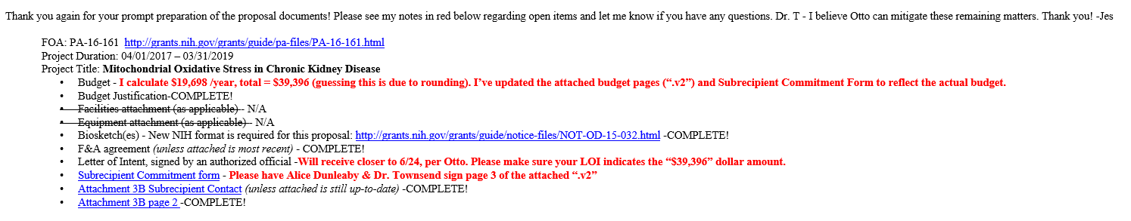

Slide 14
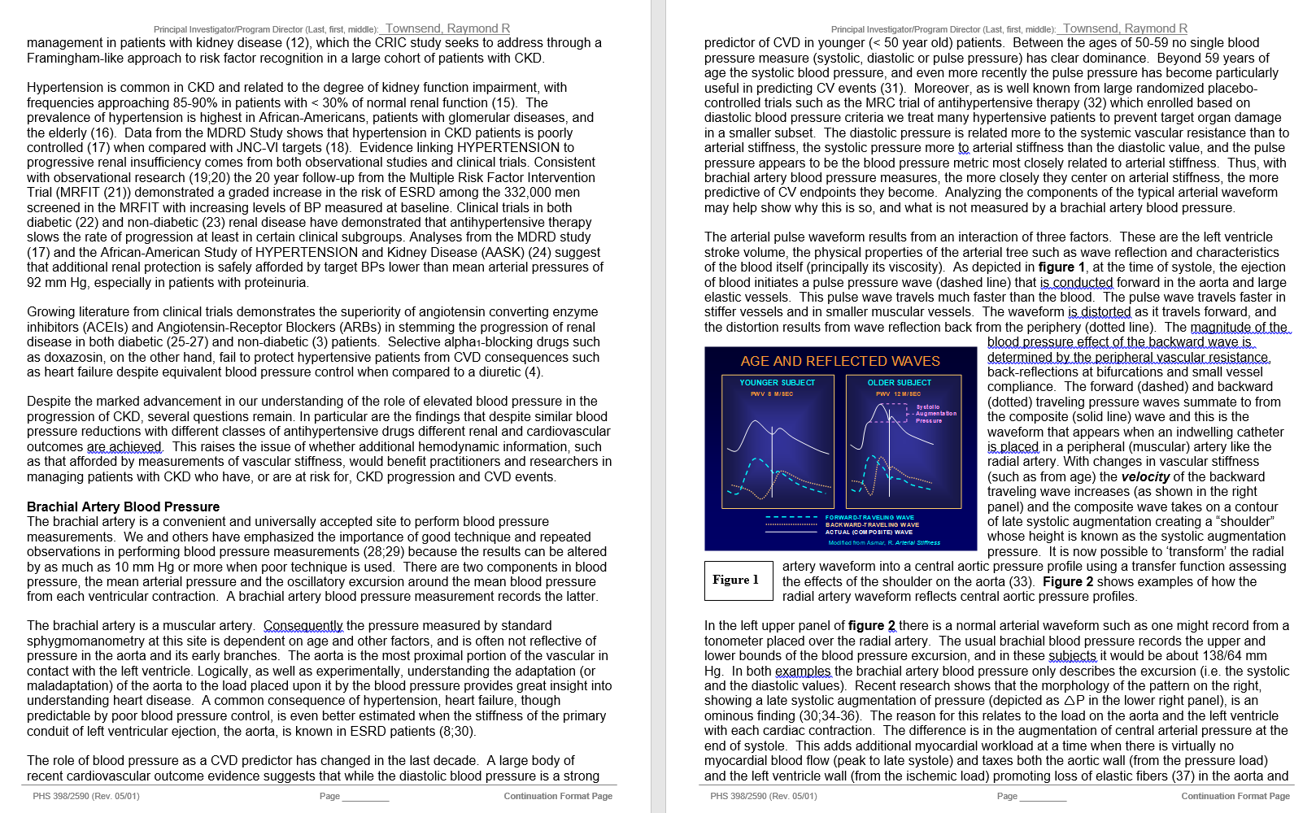
A few graphics help breakup the monotony of text

Slide 15
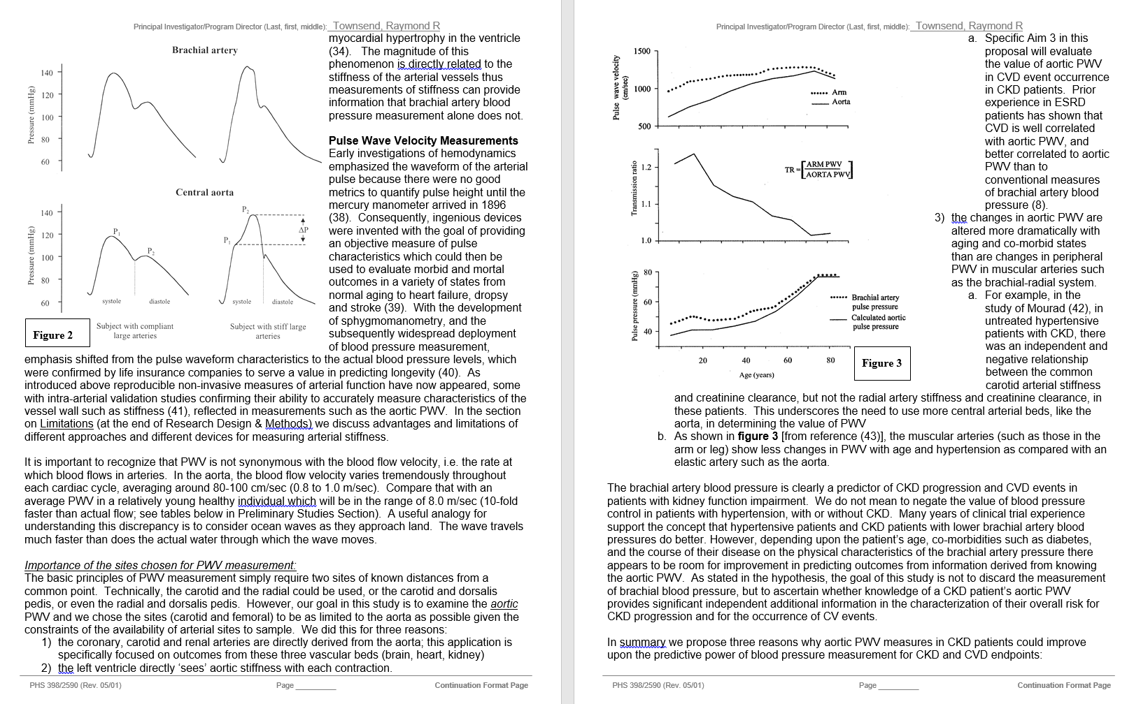

Slide 16
The analysis section
Describe how the data will be gathered, tabulated, and stored
Describe the analysis plan – often you can enlist the help of a statistics person in this section – but take some time to understand the analysis plan. If you don’t know what your analysis approach will entail, and whether it’s the right way to analyze the type of data you collect, your reviewer may not either
Do the power calculations with brutal honesty; often tables of power and effect size are quite useful

Slide 17
Ask yourself these questions
What if I am wrong?
What are the limitations in my approach? Address this in your grant
Are there strong opinions out there in InvestigatorLand about the best way to address this problem, the best way to measure this variable, the best way to screen for this disorder …

Slide 18
IMPORTANT
Have you published in the area you are planning to investigate?
Have your collaborators published in the area you are planning to investigate?
Have your collaborators published with you before?

Slide 19
Sidebar on K awards
Mentor, Mentor, Mentor
Good idea with some innovation, and a solid approach
Mentor’s Letter – if unenthusiastic, if your name is misspelled, if you appear to be yet another warm body in a lab machine this wont bode well
Ensure you read the details in the K award description
  Is there training planned
  Is training supported by fellowship $ or things like Penn’s K12 award
  Are there Institutional commitment requirements
  Will you have the protected time needed

Slide 20
One approach
Deadline February 5th 2020
R01 target
Its November now
You should already have your H₀ and AIMS in at least a near draft format
Start the discussion with your grants admin and develop your checklist
Send your Intro/AIMS to at least three colleagues who are able to provide some feedback for you

Slide 21
Approach-2
By early December have your Strategy/Approach outlined
By early December arrange time with a Stats person (may need more than two or three meetings)
By early December organize your preliminary data – a combination of published (for assuring the Reviewer your methods work in your hands), and in-process demonstrating feasibility if gathering new data, or branching into a new population
Get the Intro/AIMS back and revise. If it appears that they seem feasible to others work on developing the strategy. Organize your strategy/approach by each AIM, and discuss the anticipated results, limitations

Slide 22
Approach - 3
By mid-December finish a draft of the Strategy/Approach
Send your AIMS around again, and if you can include one or two new readers to look at them so much the better
Don’t be afraid to blow things up and start over if an AIM just doesn’t work
Save your drafts with filenames that have the date in them – that’s just plain useful advice

Slide 23
And when you feel like your have a break
Begin to develop the Human Subjects Section (where applicable)
Write the abstract (beware of space restrictions – practice it)
Construct the Resources page (often a colleague will have one)
Seek help on the budget process
  From the grants admin
  From units like the CHPS
  From the Investigational Drug Service (where applicable)
  For research prices for labs, imaging, accessing data in PMACS datasets
  For reimbursing research subjects (when applicable)

Slide 24
Approach - 4
Do you need letters of support?
Have you constructed your biosketch? (Definitely follow directions here – this one is a moving target)
Do you need biosketches from others
Do you know what “key personnel” are
Do you know what “Salary & EB” means
Are your references correct – periodically make sure that the article you think you cited from your reference manage is the correct one. Sloppy attention to details makes reviewers suspect sloppy approach to science

Slide 25
Approach - 5
Do you need an enrollment target table
Are you giving an Investigational agent and needing an IND
Are you using an Investigational device and needing an IDE
Well, you get the idea by now

Slide 26

Approach – 6 (standing alone)
Read a funded grant

Slide 27
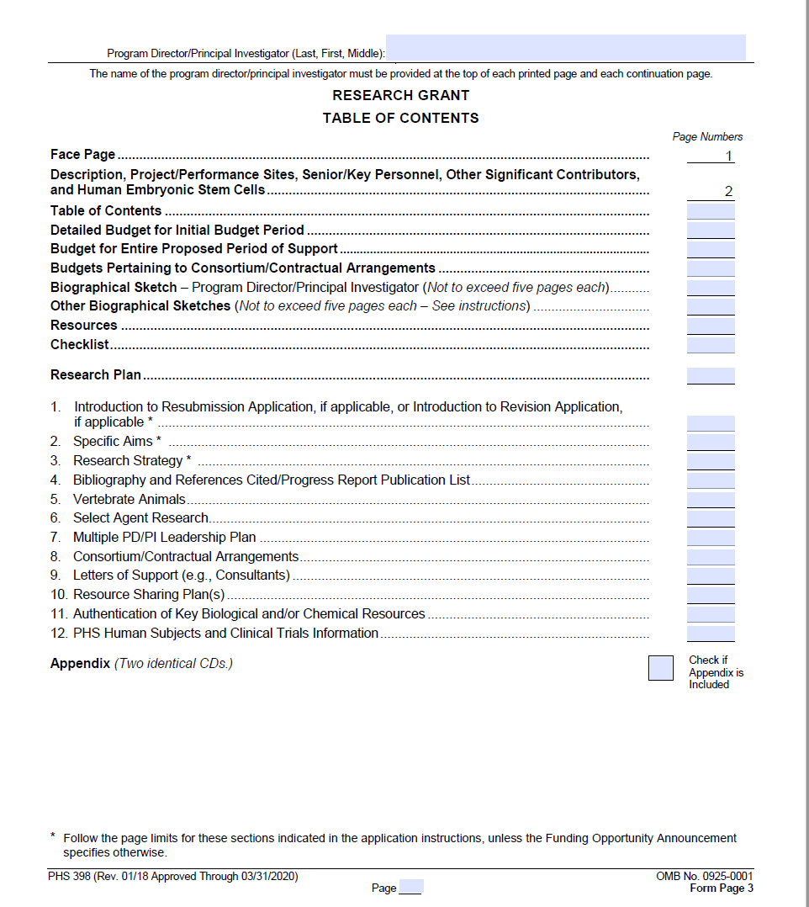
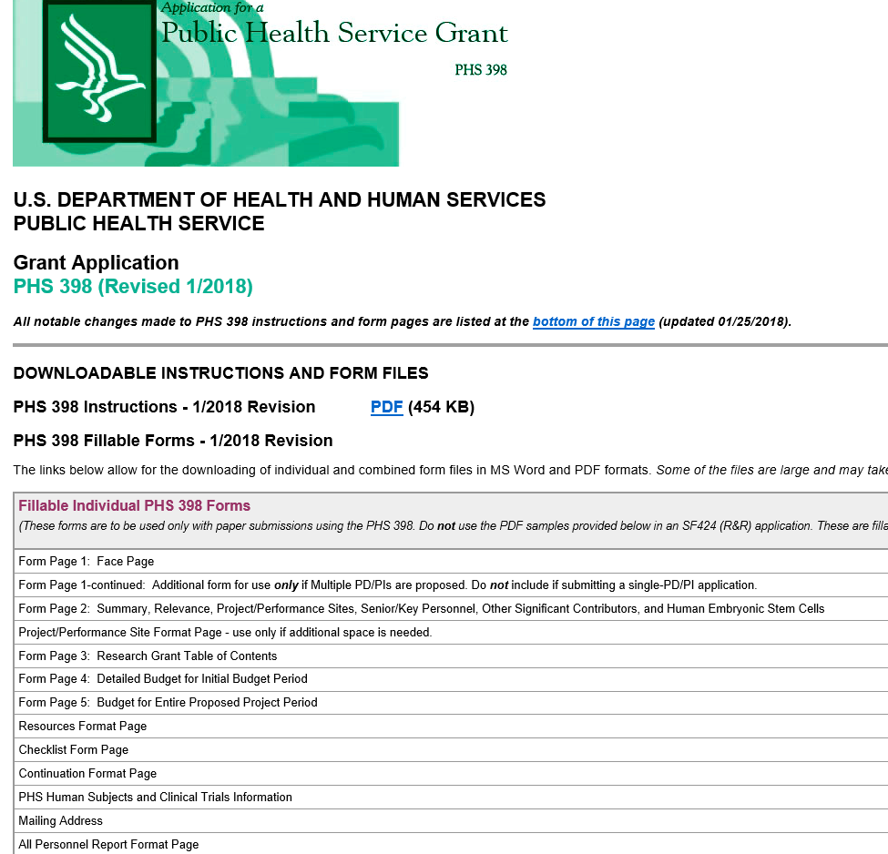
https://grants.nih.gov/grants/funding/phs398/398_forms.pdf

Slide 28

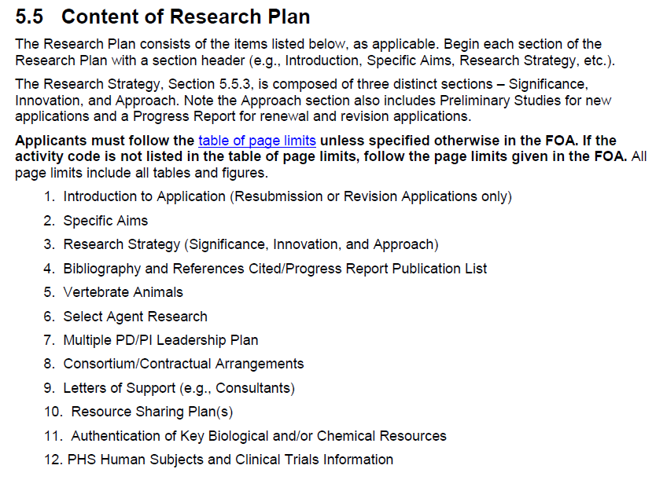
https://grants.nih.gov/grants/funding/phs398/phs398.pdf

Slide 29
The absolutely-don’t-forget-this list
Deadlines are that: if you don’t get it submitted in time, it’s dead
A grant is many faceted beast – you need ruthless readers, brilliant biostatistics, great grants-admins, and an innovative idea
Keep it simple
Keep it focused on your Hypothesis and AIMS
Pay attention to the details like font size and margins

Slide 30
The essential list
Is this Scientifically important (impact)?
Is it Innovative?
Is it plausible and is the Approach sound and if successful will the scientific question be answered?
Is the Investigator ‘credible’?
Is the Environment ‘credible’?

Slide 31

Last Minute stuff
Cover Letter
Get advice on which study section

Slide 32
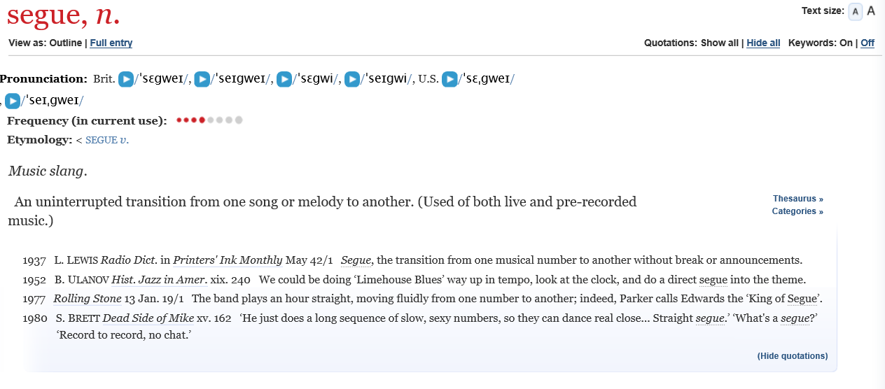
SEGUE
https://oed.com/view/Entry/174899?rskey=CxBIWM&result=1&isAdvanced=false#eid

Slide 33
Putting it all together
Ray Townsend
November 13 2019
1200h – 1220h

Slide 34
An example
To illustrate the steps involved in taking the steps needed to pursue clinical research

Slide 35
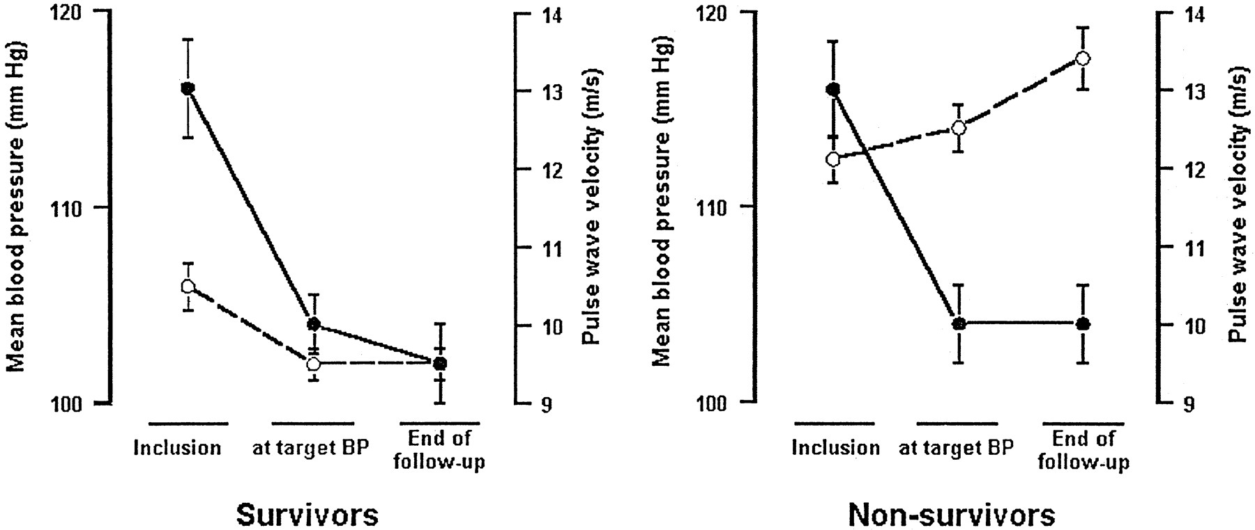
An observation
In France, work done on dialysis patients shows that their arteries, when stiff, don’t de-stiffen when treated for hypertension, and they die
Mean BP--black dots
APWV--white dots
(Figure from Guerin Circulation 2001)

Slide 36
Personal Example
I was impressed how some people, especially those with CKD, were very difficult to control when referred to me for resistant hypertension
I wondered if knowing more about vascular stiffness might help here

Slide 37
How do I proceed with my idea?
Who does it interest?
How big a picture are you trying to paint?
How focused is your idea?

Slide 38
But I had no prelim data
So, get some

Slide 39
Step 1
Draft your proposal into a protocol with aims, hypotheses and a research strategy and get started

Slide 40
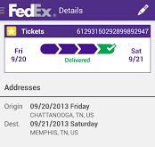


First wrinkle in the story -
Buying a research device for human use from Australia
Sydney, AUSTRALIA
PHILADELPHIA, PA
MEMPHIS, TENN

Slide 41
Step 1 – getting permission
Draft your proposal into a protocol with aims, hypotheses and a research strategy and get started
Get IRB approval

Slide 42
Results of Step 1
Once I had IRB approval AND a Consent Form AND …
After I got my device out of jail, we set to work collecting data
AND once I had a chance to study my subjects in the CHPS (‘CTRC’ then)
AND After studying nearly 40 people (convenience number) we were set to go

Slide 43
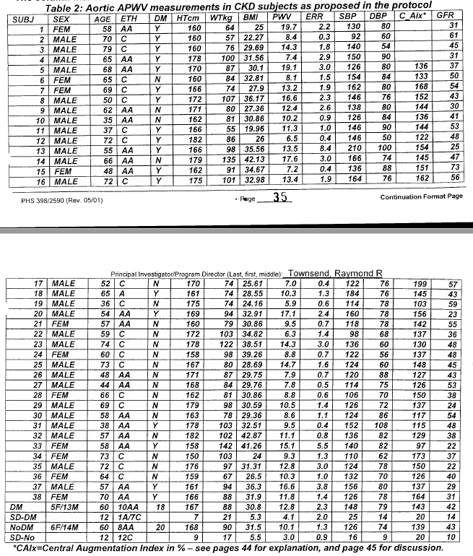
From the original grant
A few gems were already showing up

Slide 44
Step 2: Apply for funding: AIMS, AIMS, AIMS
If you have an FOA/PA read it carefully
If you are going for a new grant (R type is common) then you develop them on your own
The format is a bit unstructured in that you have one page to present your rationale and your aims/hypothesis (or hypotheses)
If you goal is a K series grant work hard on how you choose a mentor

Slide 45
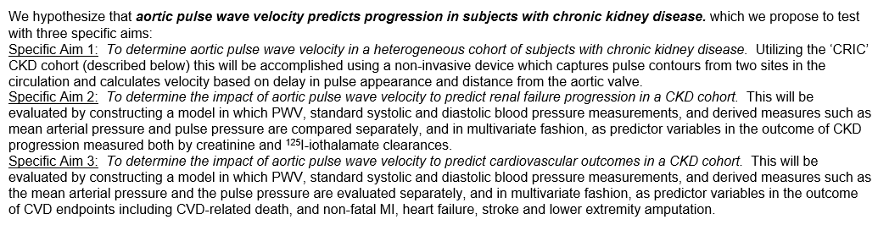
An example of three (independent) AIMS

Slide 46

What does Penn have that makes you competitive?
CHPS
  Supplies, centrifuges, freezers, bathroom**
Track record of success
Electronic Health Record
Support when writing the grant
  Biostats
  Colleagues who critiqued it

Slide 47
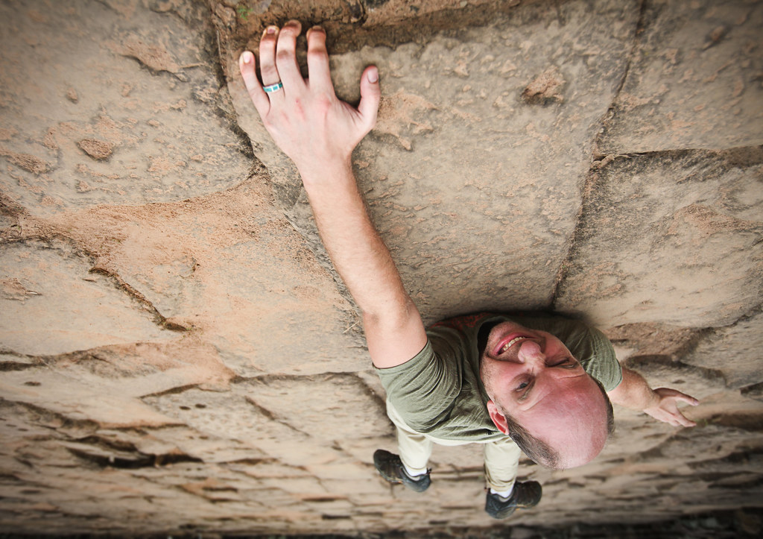
What happened next

Slide 48
The “pink sheet”
You will get something we call a critique. Years ago they were the pink copies from a “carbon copy” set

Slide 49
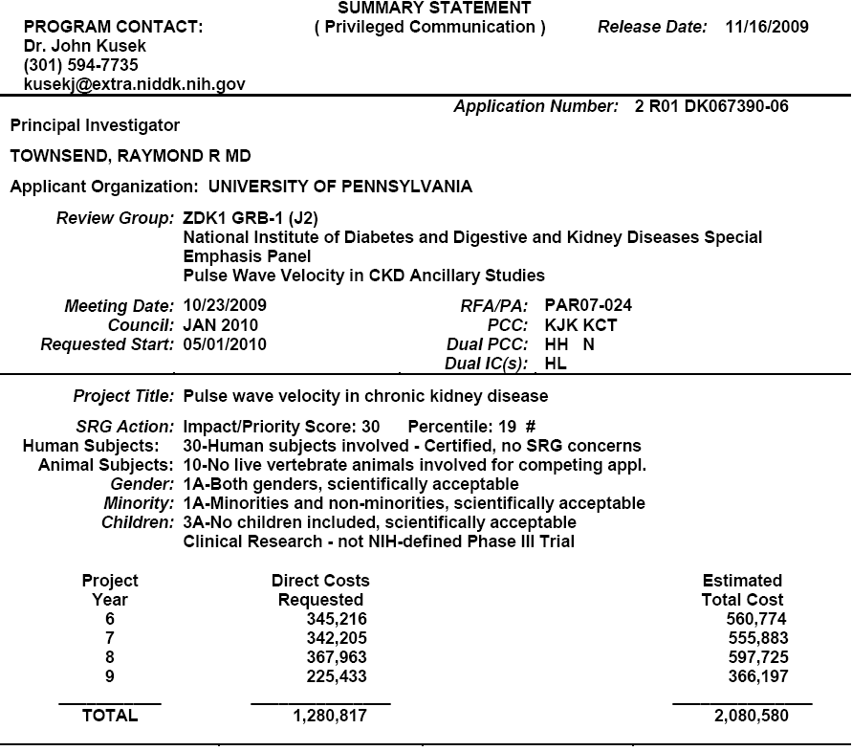


Slide 50
Was very close
Revised and resubmitted as quickly as I could
Answered every critical comment, often briefly, but did not miss any of them nor did I dismiss them as unrelated

Slide 51
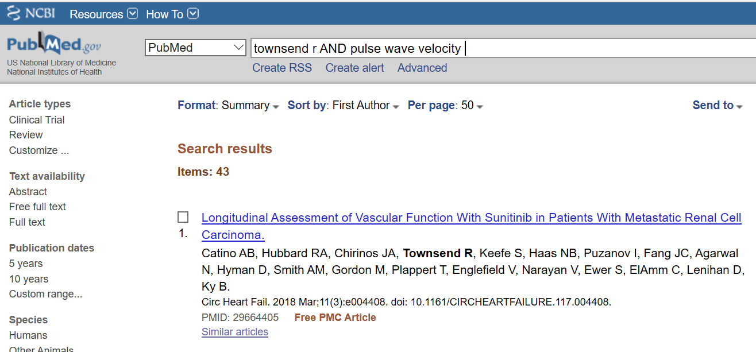
AND eventually ….

Slide 52
